Slide 1
How to Calculate Tax and Total Price
Consumer Math

Slide 2
Sales Tax
Total Sales Tax = Item(s) cost x
Sales Tax Rate [represents as a
percentage {%}]

Slide 4
Total Price
Total Price =
Item(s) cost + Total Sales Tax

Slide 6
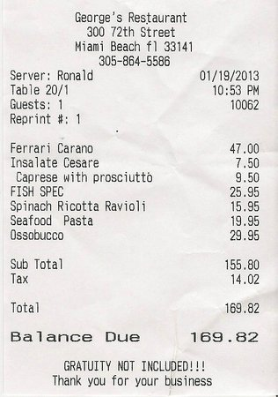
Steps
Add up all the items (Sub Total)
Find the Tax
Tax = subtotal x sales tax rate (%)
Add the Tax and Subtotal together to get the Total (Balance Due)

Slide 7
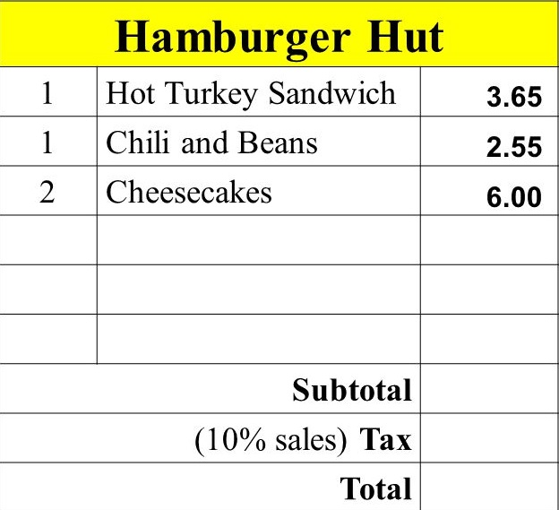
Find:
Subtotal price of items
Tax of subtotal price
Total price

